Slide 1

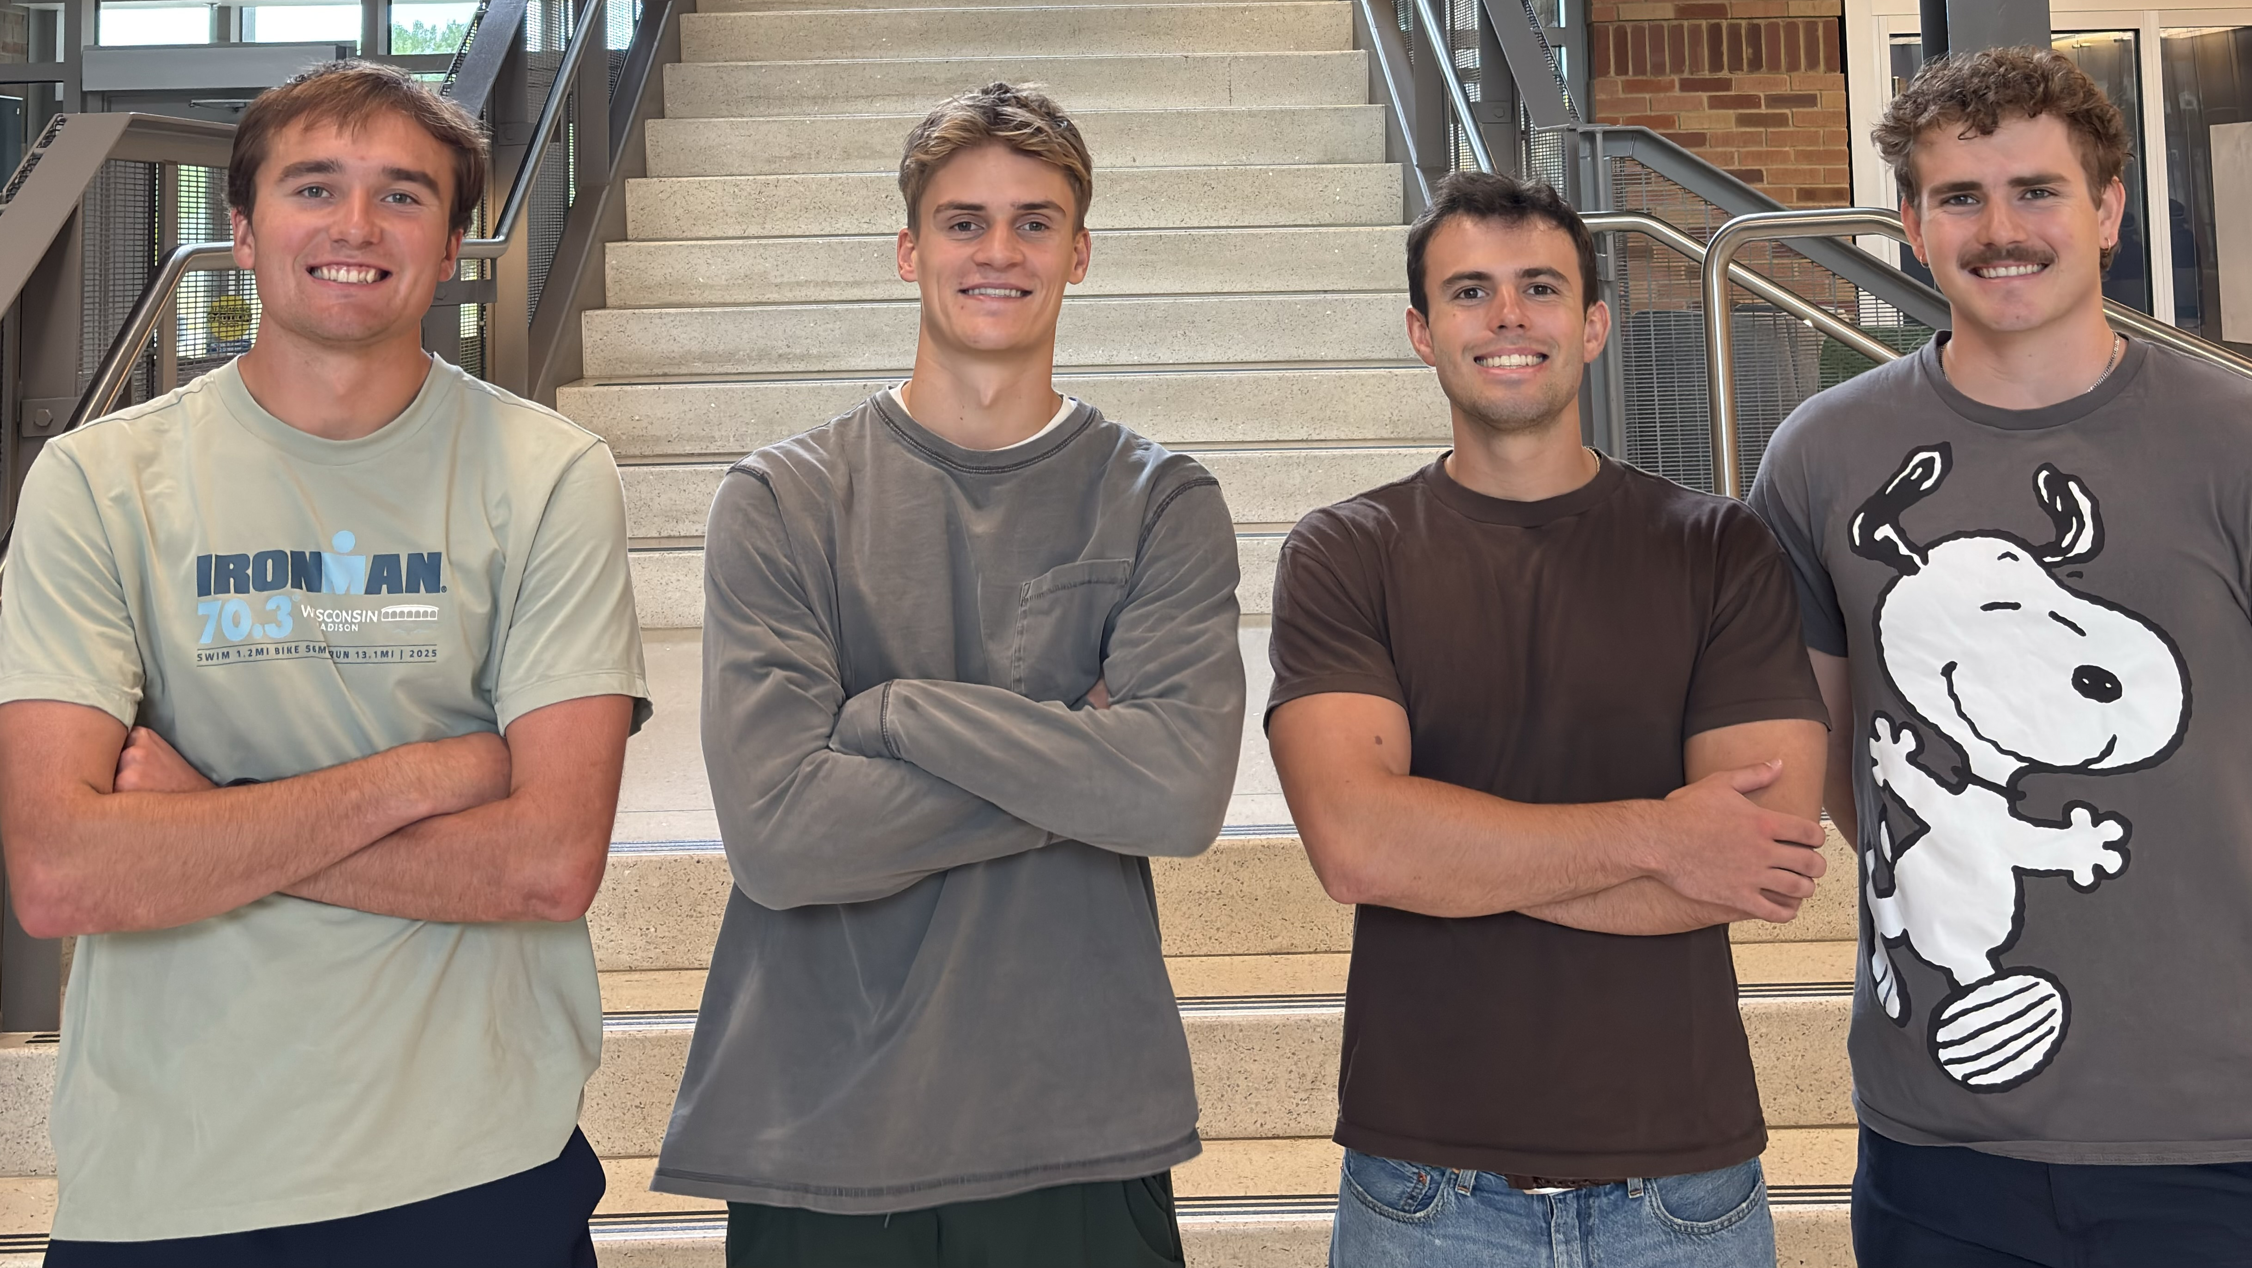
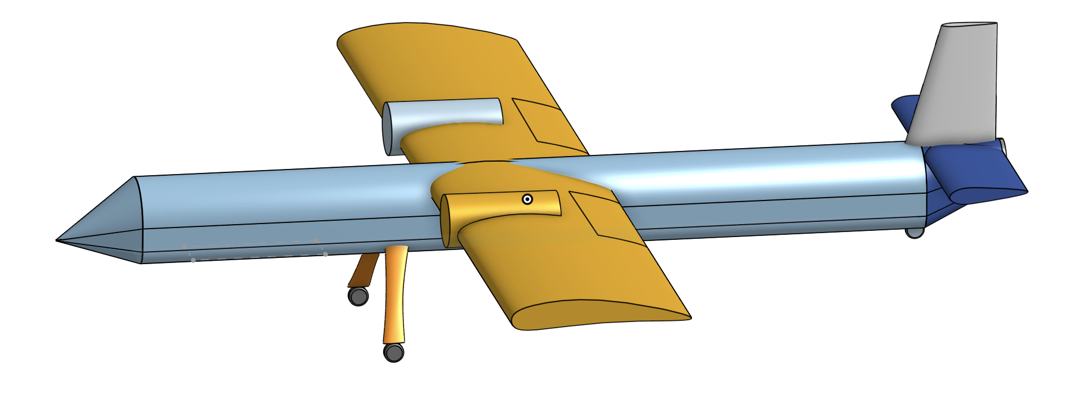

TEAM J.O.Y. Design Review 1
Noah Judelson, Zack Wojtalik,
Kai Matthews, Cash Collum
Notes:
Noah – 30 second intro

Slide 2
Agenda
Our Design
Tools and Sizing Method Development
Sizing, Mission Analysis and Constraints
Structural, Stability, and Operational Considerations
Conclusions
Notes:
Noah – 30 second intro

Slide 3
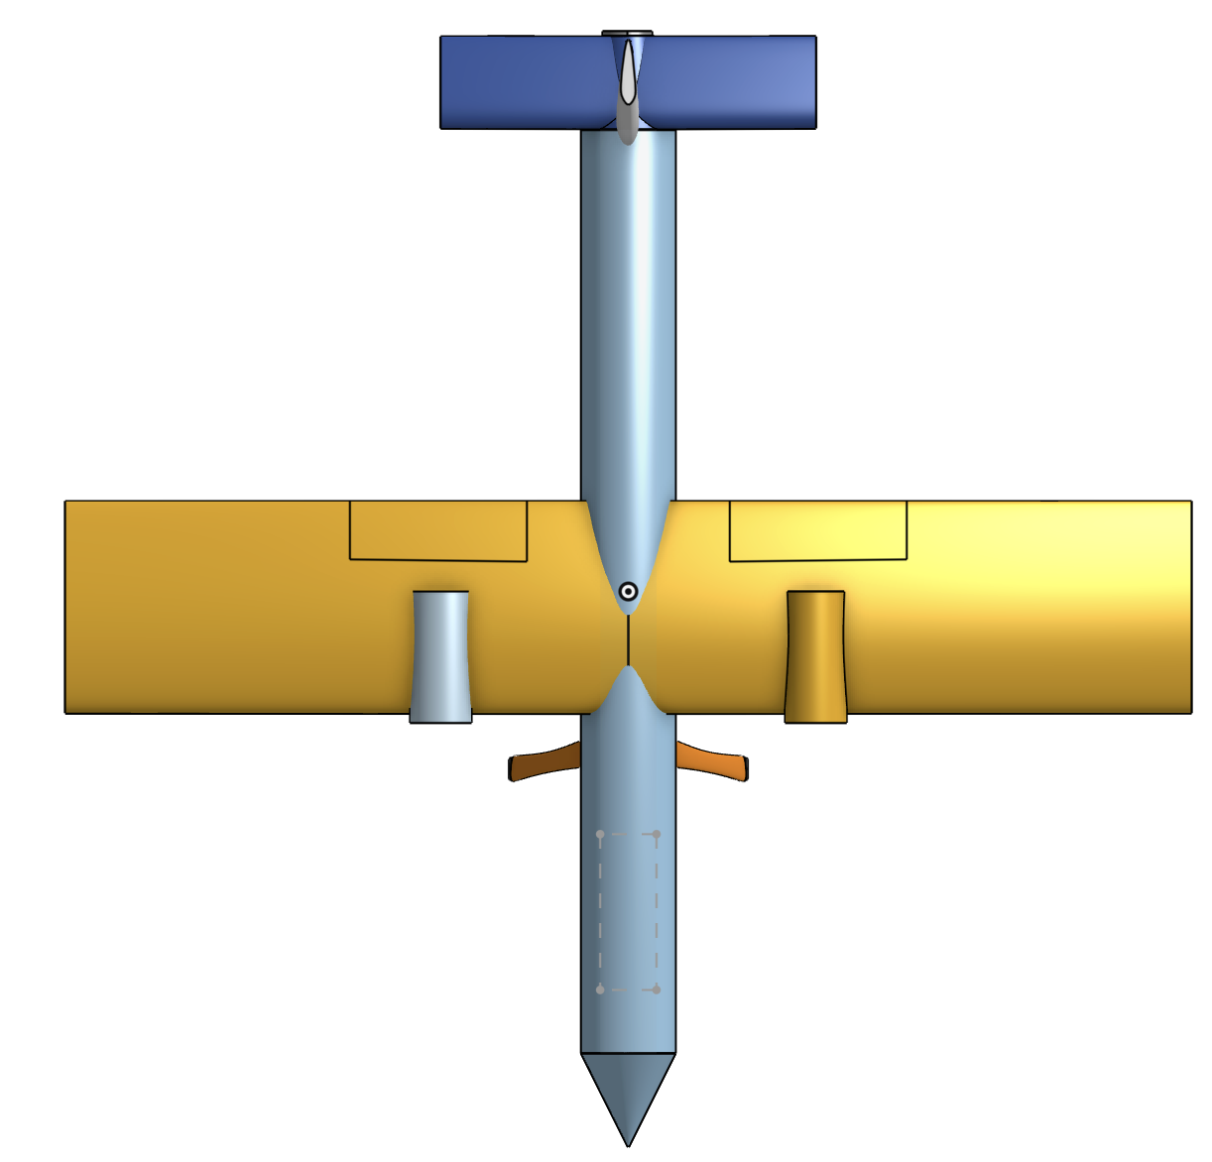

Our Design Concept
Conventional Design
High Lift Device
  Blown Flaps
High Wing
Twin Propellor
Tail Dragger
Blown Flaps
Tail Dragger
Notes:
Kai - 2 min

Slide 4
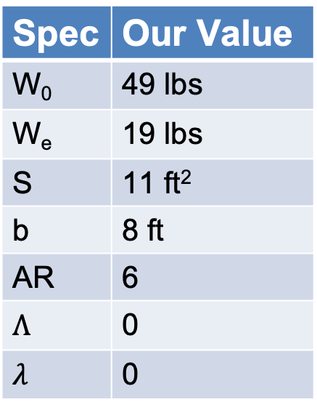
Our Design & Mission Profile
Spec | Our Value
W₀ | 49 lbs
W_{e} | 19 lbs
S | 11 ft²
b | 8 ft
AR | 6
$$Λ$$ | 0
$$λ$$ | 0
Notes:
Quick yap about the general dimensions of our aircraft and the mission profile – climb segments, top speed segment (150mph for 10min), 1 hour cruise segment, loiter and descent

Slide 5
Tools and Sizing Method Development
Notes:
Kai - 2 min

Slide 6
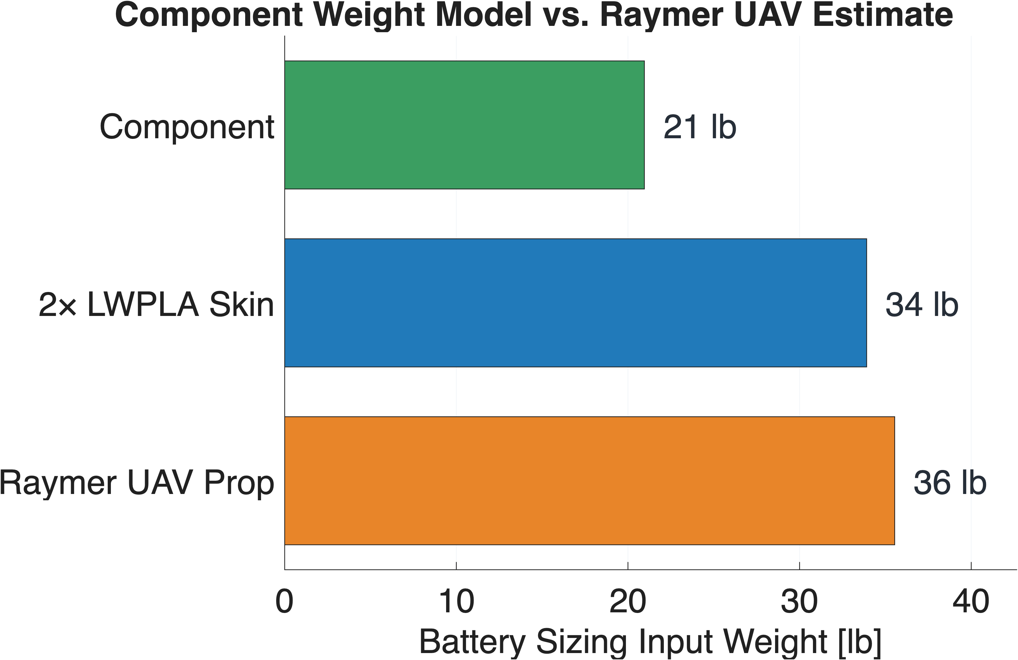
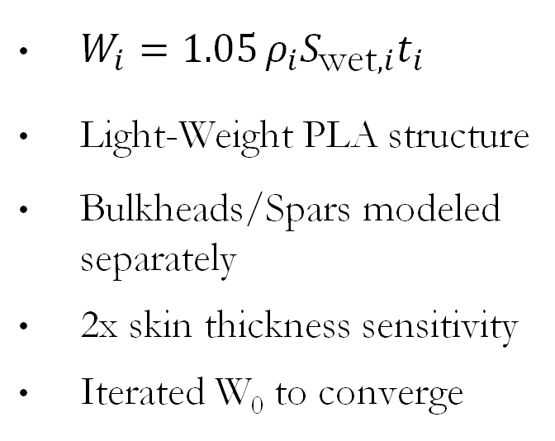
Component Weight Model Modification
$W_{i}=1.05 ρ_{i}S_{\text{wet},i}t_{i}$
Light-Weight PLA structure
Bulkheads/Spars modeled separately
2x skin thickness sensitivity
Iterated W₀ to converge
19 lb
31 lb
30 lb
Notes:
Noah – 45 seconds
$W_{i}=1.05 ρ_{i}S_{\text{wet},i}t_{i}$
surface area × thickness estimates the material volume. Multiplying by density gives that part’s weight. The 1.05 is a 5% multiplier used in the code.
- Included skin thickness sensitivity study to show Raymer is definitely overestimating, and note that this estimates a 100% infill LWPLA

Slide 7
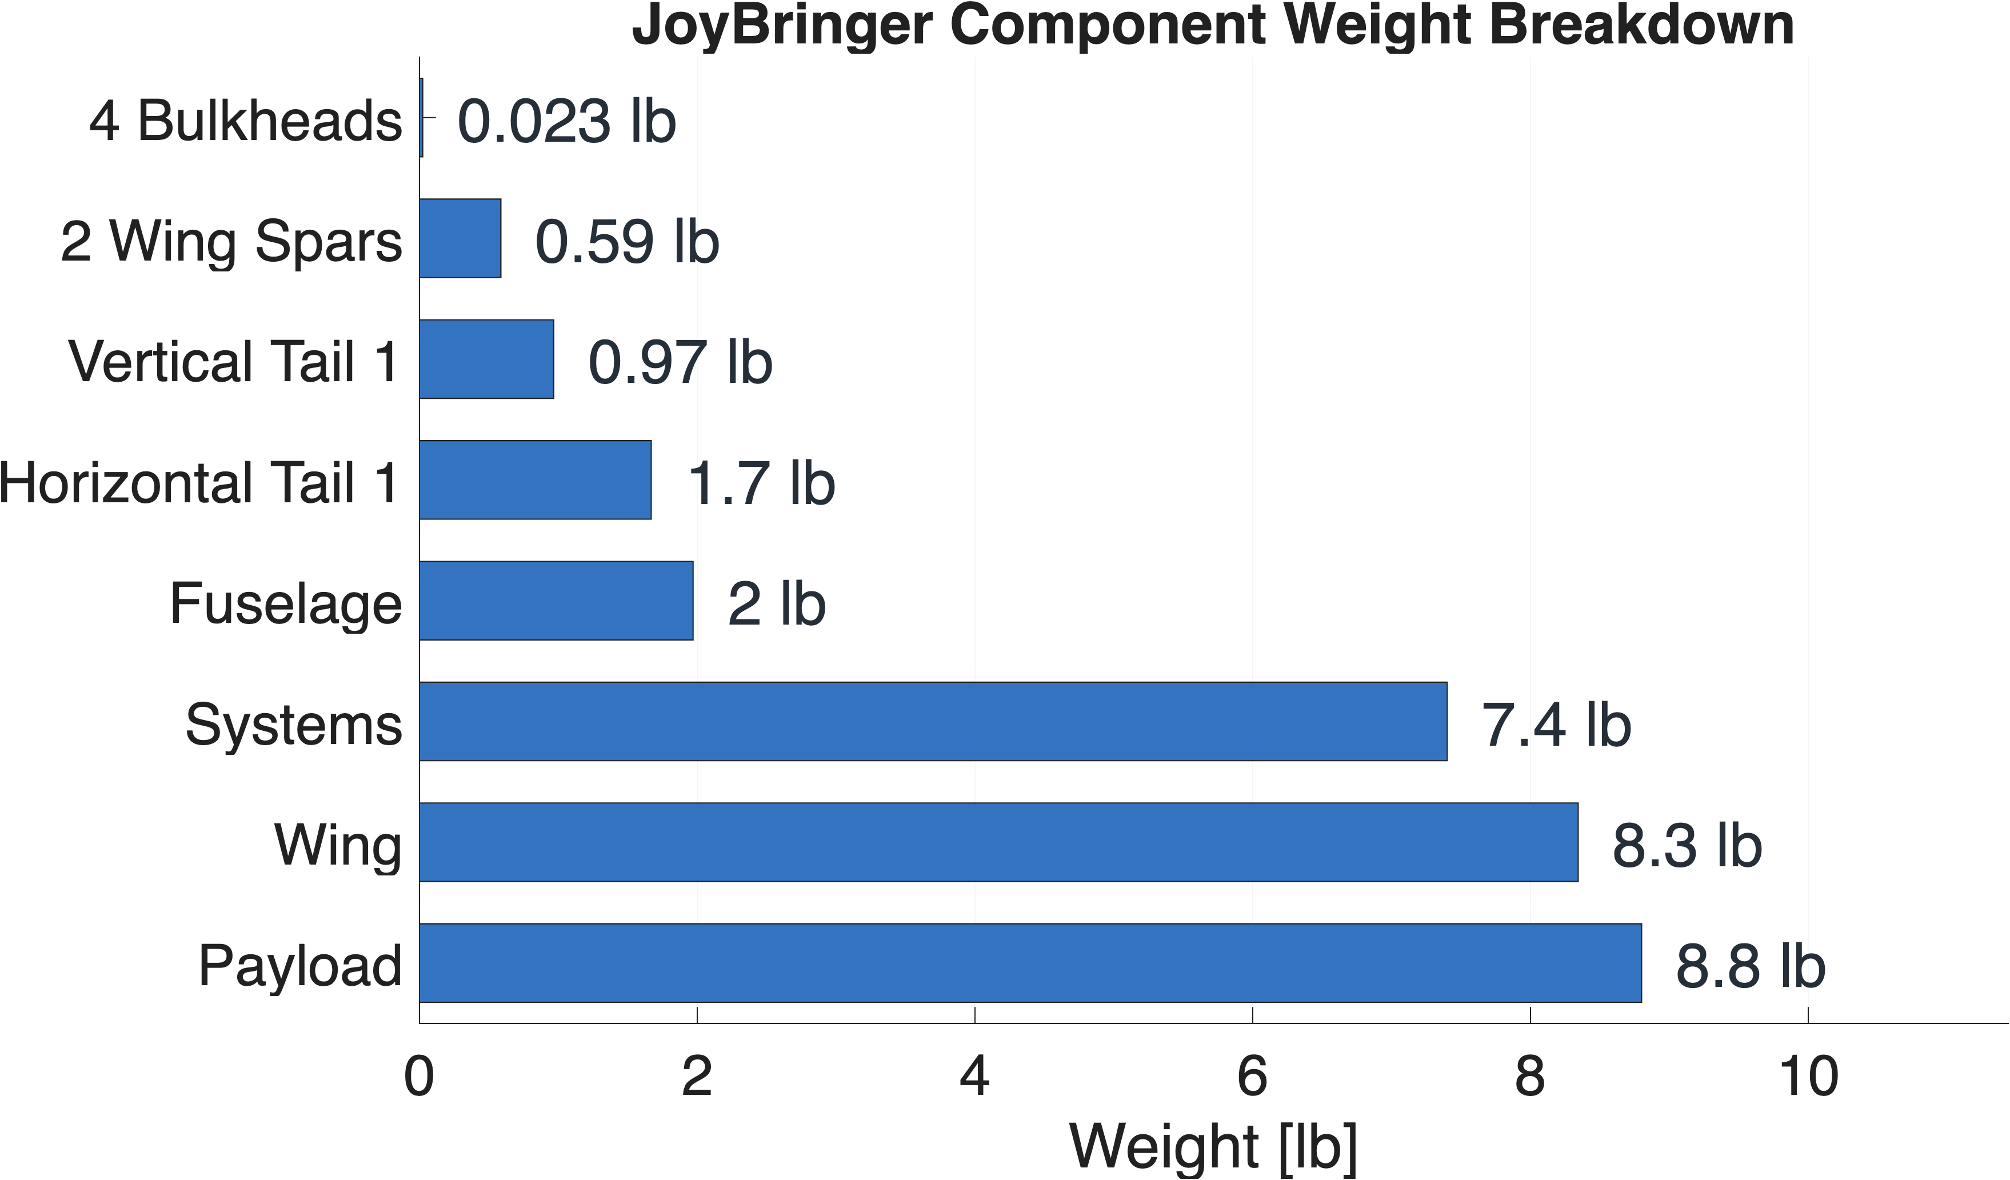
Assumptions and Breakdown
Assumption | Value
LWPLA Density | 38 lb/ft³
LW Balsa Density | 5.5 lb/ft³
Wing Spar (Nested CF Pair) | 0.3 lb
Wing Skin Thickness | 0.2 in
Stabilizer/Fuse Skin Thickness | 0.1 in
100% PLA infill
Minimal wing support
LG/Actuator weight
Notes:
Noah – 45 seconds
Spar info: 16/14mm & 14/12mm, 0.29 lbs per

Slide 8
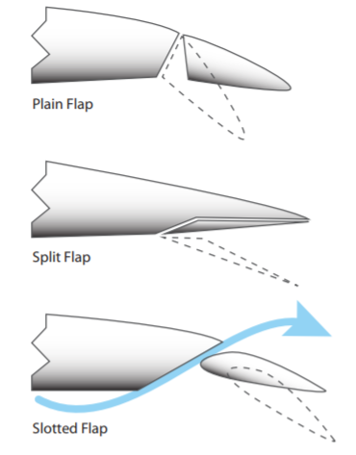
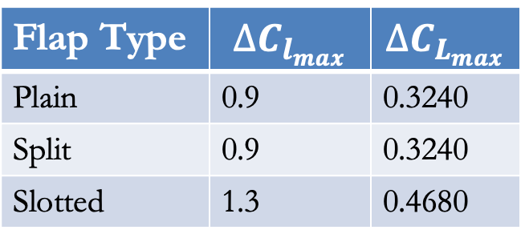
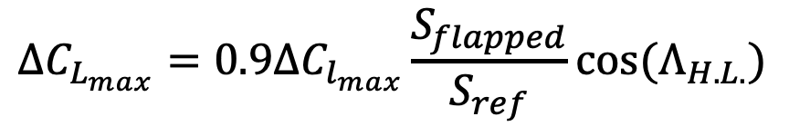
High Lift Devices
$$∆C_{L_{max}}=0.9∆C_{l_{max}}\frac{S_{flapped}}{S_{ref}}cos⁡(Λ_{H.L.})$$
Plain
Flap Type | $$∆C_{l_{max}}$$ | $$∆C_{L_{max}}$$
Plain | 0.9 | 0.3240
Split | 0.9 | 0.3240
Slotted | 1.3 | 0.4680
Split
Slotted
Raymer, D. P., Aircraft Design: A Conceptual Approach, 7th ed., AIAA Education Series, American Institute of Aeronautics and Astronautics, Reston, VA, 2024.
Notes:
ZACK – 1.5 min
Raymer said to take 60-80% of these values
Can also implement leading edge slot – increases stall angle of attack and can be fixed
I have pdf of blown flap paper for prop planes, they used a 4" propeller on a 2D airfoil in a wind tunnel. Results show that more blowing will yield a higher sectional lift coefficient like we expected for a slotted flap design. With flap deflection we can achieve a conservative Cl estimate of 2 but potentially up to 4.
1.5 min

Slide 9
Sizing, Mission Analysis and Constraints
Notes:
Kai - 2 min

Slide 10
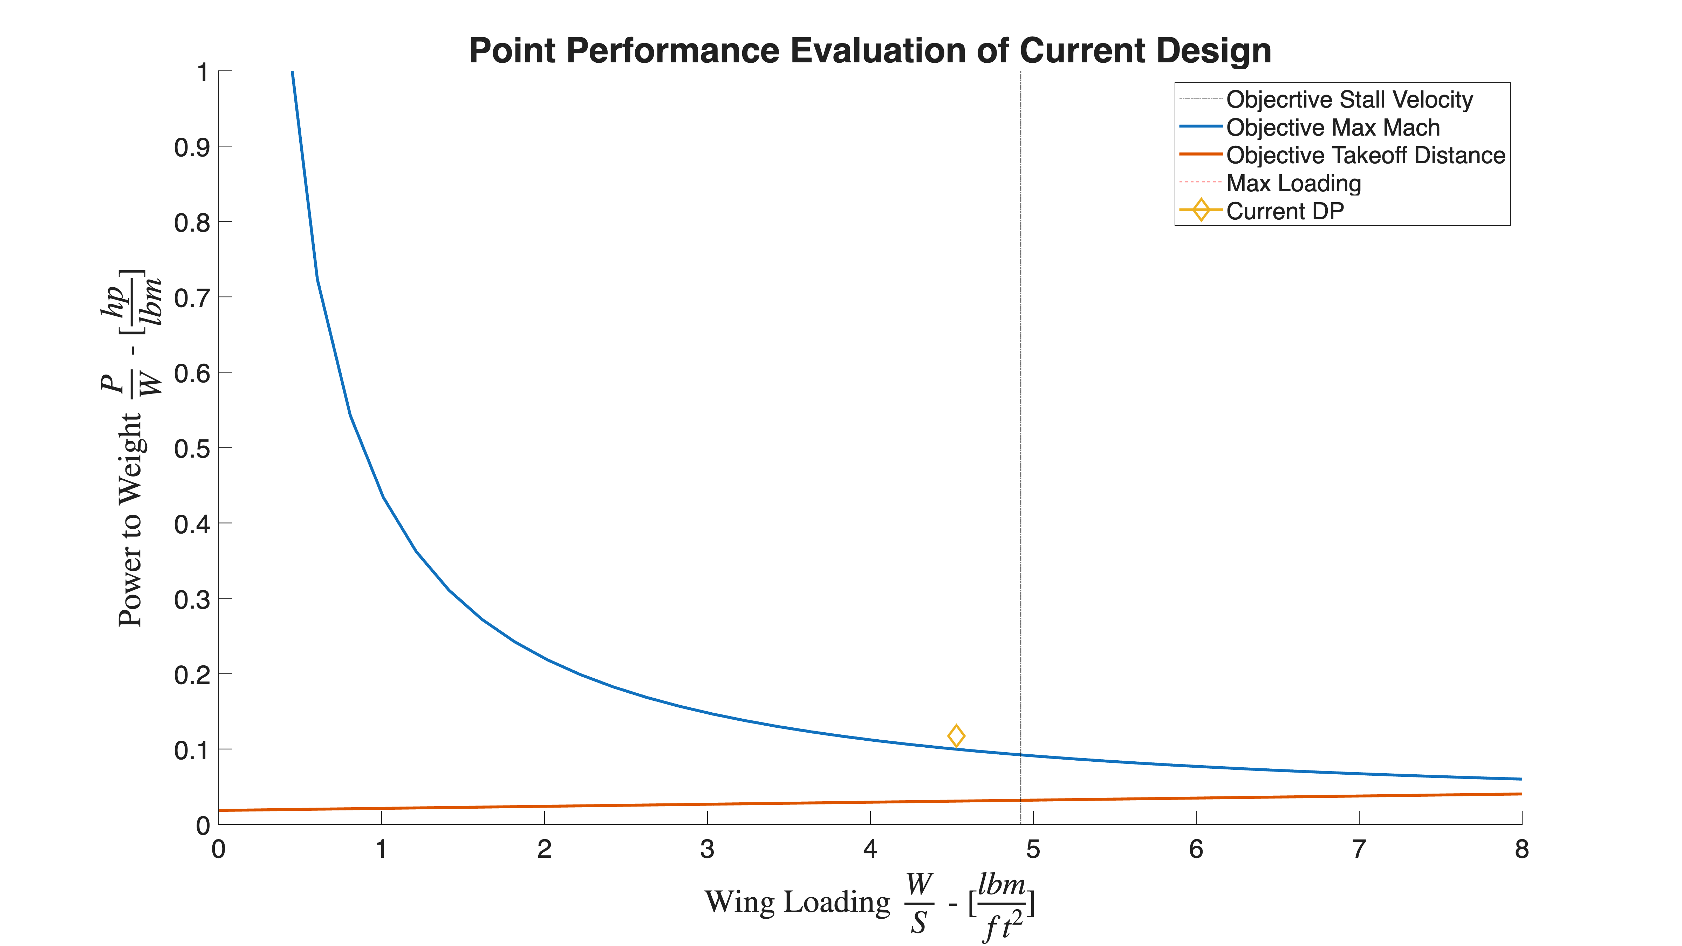
Point Performance Evaluation
Mission Characteristics
150mph Max Speed for 10 minutes
1.5 hr flight time
Cruise @ 15,000ft
Notes:
Zack - 1.5 min

Slide 11
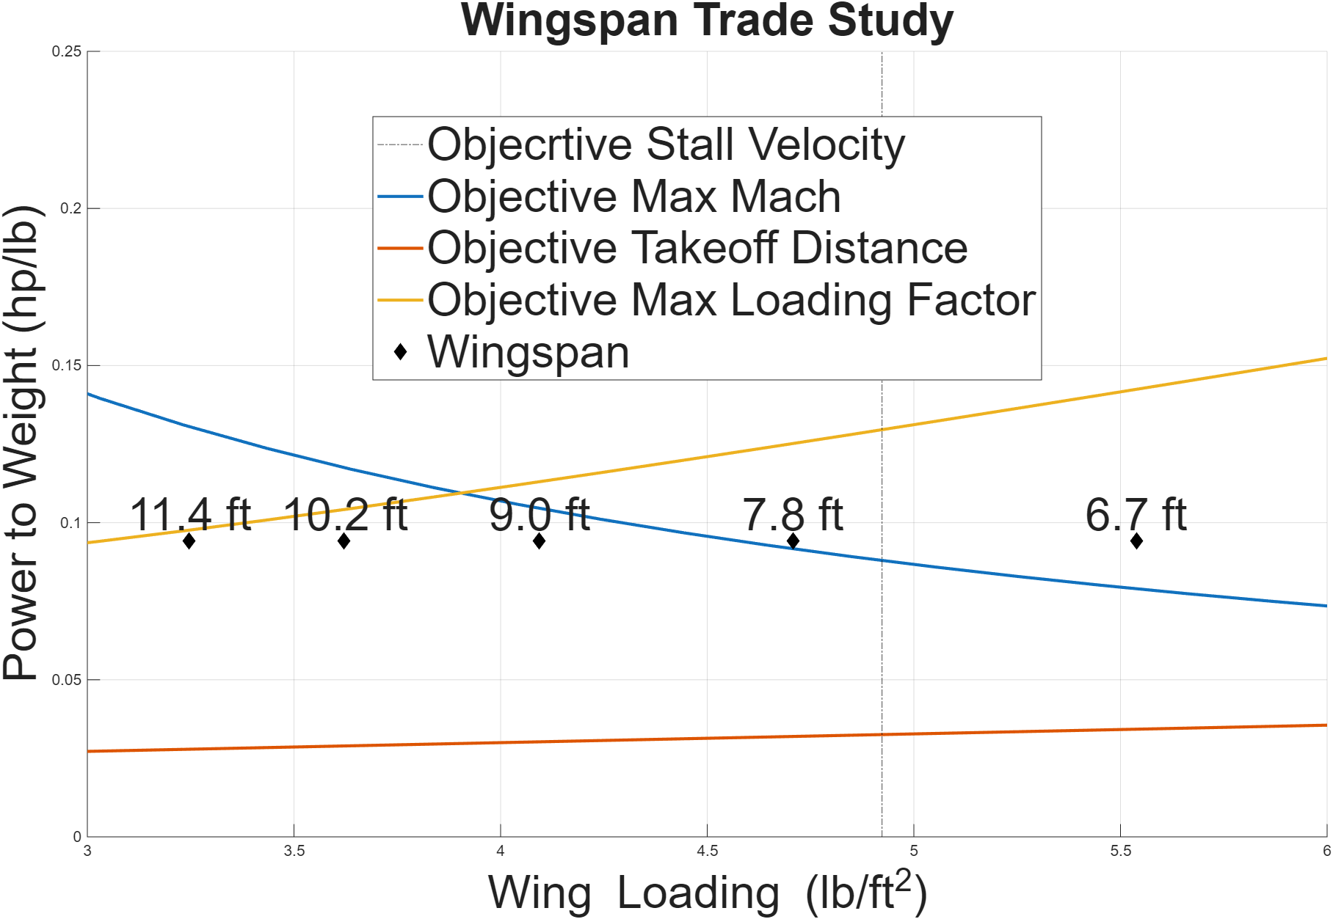
Wingspan and Root Chord Analysis
Original Values showed too much loading
Increase Planform Area and Aspect Ratio for better loading
Diminishing return and manufacturing concerns occur as wingspan increases
Notes:
Cash - 1.5 min

Slide 12
Structural, Stability, and Operational Considerations
Notes:
Kai - 2 min

Slide 13
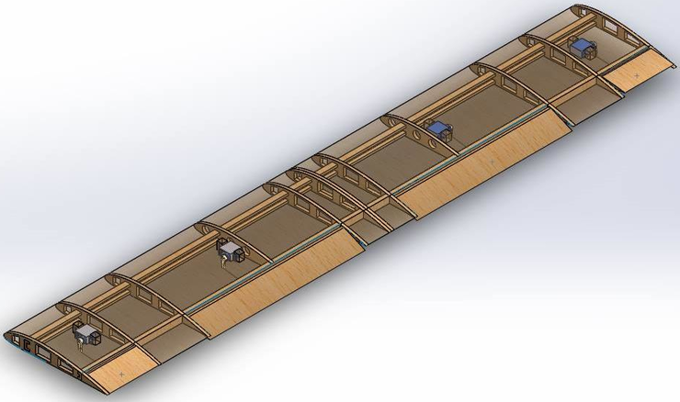
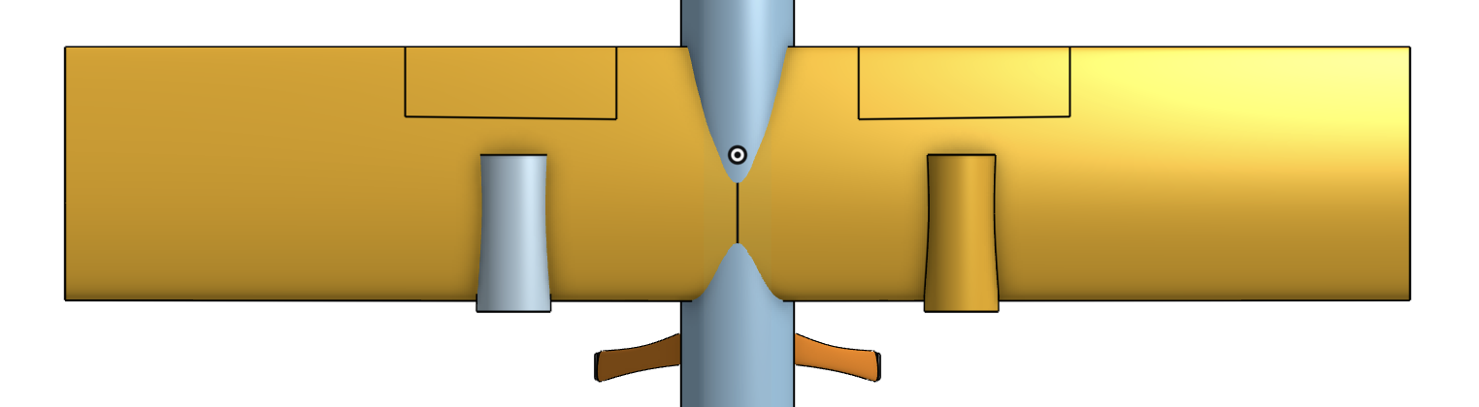
Structural Considerations
Segmented LW-PLA construction
  Precise, replicable, size limited
  Plan to reinforce joints
High lift devices – plain blown flaps
  Complexity vs. Lift tradeoff
Spanwise wing spar system
  Wind gust G requirements
Fixed tailwheel landing gear
  Consider landing load distribution
Notes:
Noah - 1.5 min
Segmented LW-PLA: Fits printer limits; reinforce joints to transfer loads.
Plain blown flaps: Simple mechanism; reinforce hinges and servo mounts.
Wing spar: Carries bending loads into fuselage; surrounding structure resists twisting.
Fixed tailwheel: Intended for larger-prop clearance; reinforced mounts carry landing loads without retraction hardware.

Slide 14
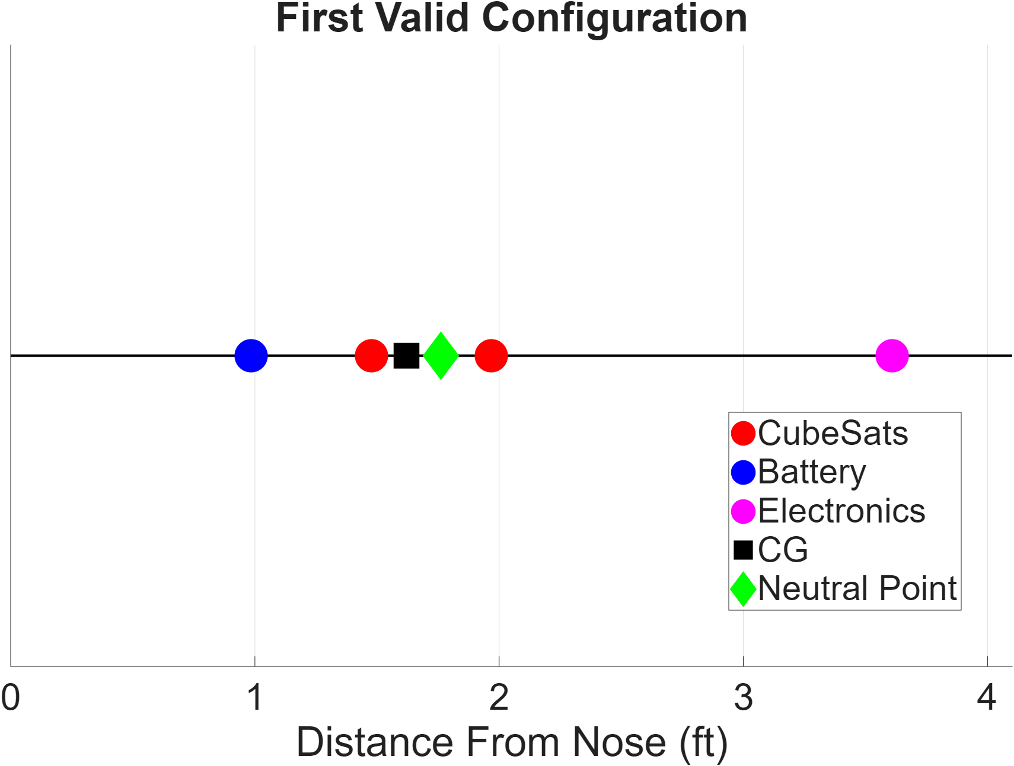
Stability Considerations
High Wing for Inherent Roll Stability
Static Margin
RFP requires between 10-15% Static Margin
Analysis using baseline values shows roughly 8 different designs
                Battery in front, Payloads surrounding CG, and Electronics in the back gives 12-14% Static Margin throughout all stages
Notes:
Cash - 1.5 min

Slide 15
Operational Considerations
Design Choice | Operational Consideration
Tail Dragger | Unstable ground steering
Blown Flaps | Decreased Landing Speed + STOL
High Wings | Less maneuverability
Notes:
Kai - 1.5 min – BE READY TO ANSWER QUESTIONS? TALK ABOUT THIS

Slide 16
Conclusions
Notes:
Kai - 2 min

Slide 17

Conclusion
Pros | Cons
High lift at low velocity | Unstable Ground Steering
Propellor clearance | Less ground maneuverability
High stability
Design Simplicity
Why Team Joy?
Meets RFP requirements
Manufacturable design
Pilotable
Notes:
Kai - 1.5 min

Slide 18
Questions?

Slide 19
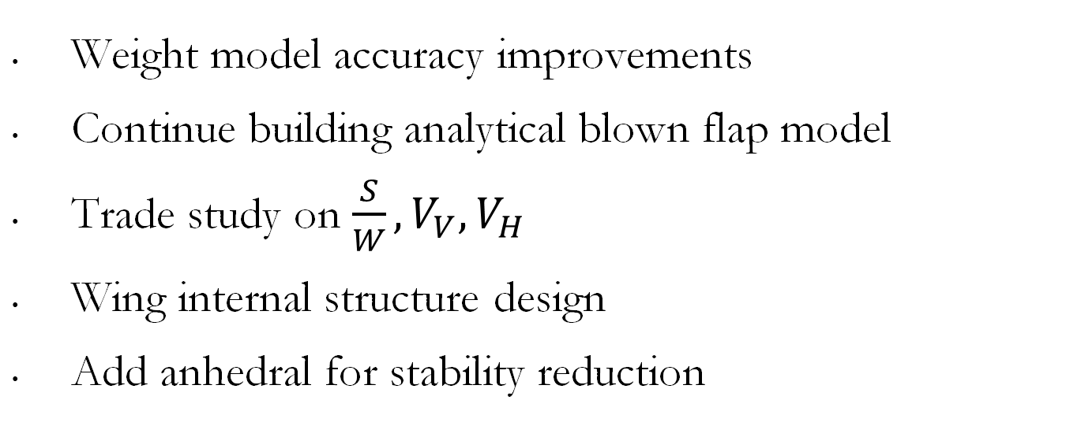
Plan for the Future
Weight model accuracy improvements
Continue building analytical blown flap model
Trade study on $\frac{S}{W}, V_{V},V_{H}$
Wing internal structure design
Add anhedral for stability reduction

Slide 20
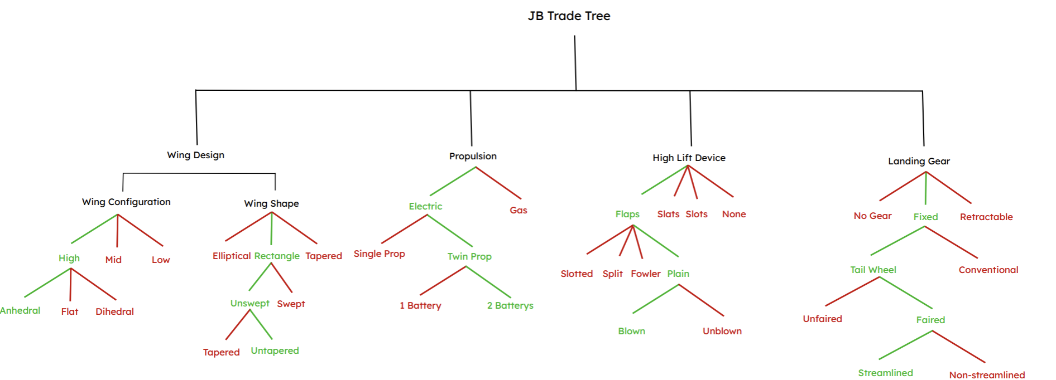
Trade Tree

Slide 21
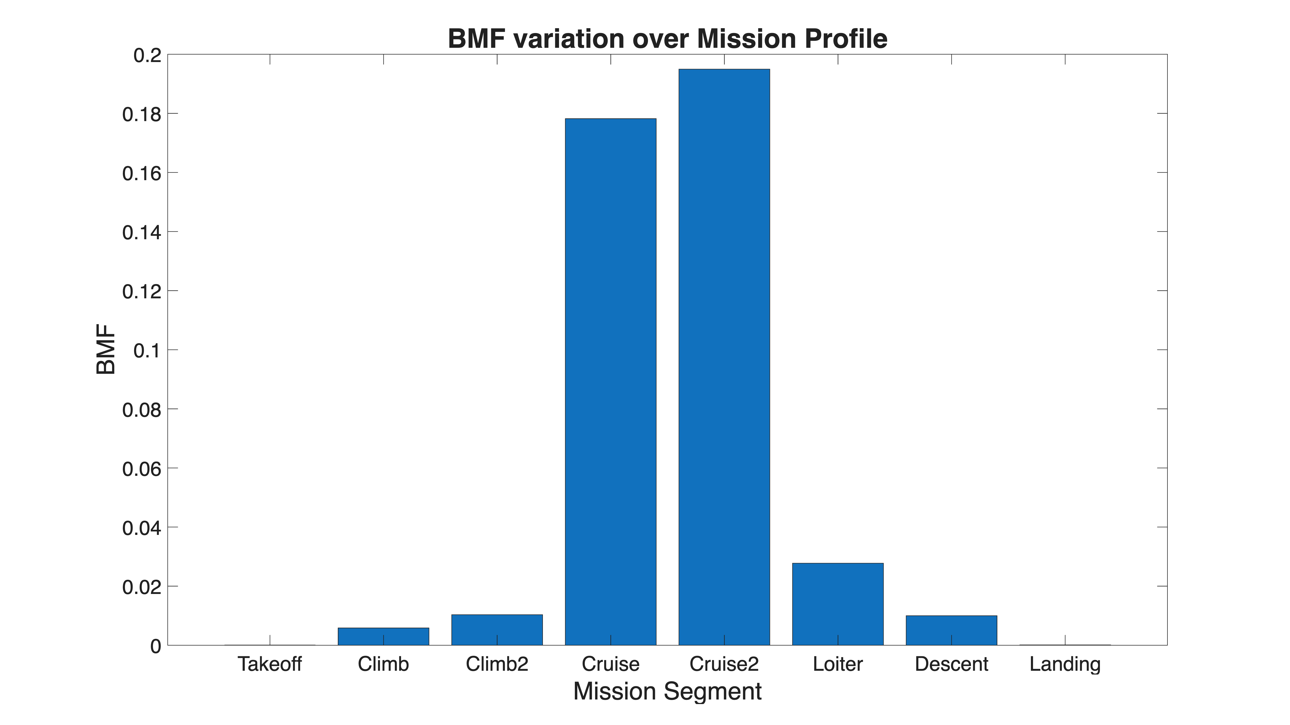
BMF Variation Over Mission

Slide 22
COTS Component Links
Motor: https://www.scorpionsystem.com/catalog/aeroplane/motors_1/sii-40/SII-4035-250/
Battery: https://store.foxtech.com/Diamond-pro-330wh-kg-solid-state-battery/
Actuator: https://www.hiteccs.com/actuators/product-details/D954SW
Landing Gear: https://whiteroseeng.com/products/tf.php
Wing Spar: https://www.readymaderc.com/products/details/86721-strix-nesting-pair-1m-3k-carbon-fiber-spar-tubes-16-14mm-14-12mm
Telemetry: https://holybro.com/products/sik-telemetry-radio-v3

Slide 23
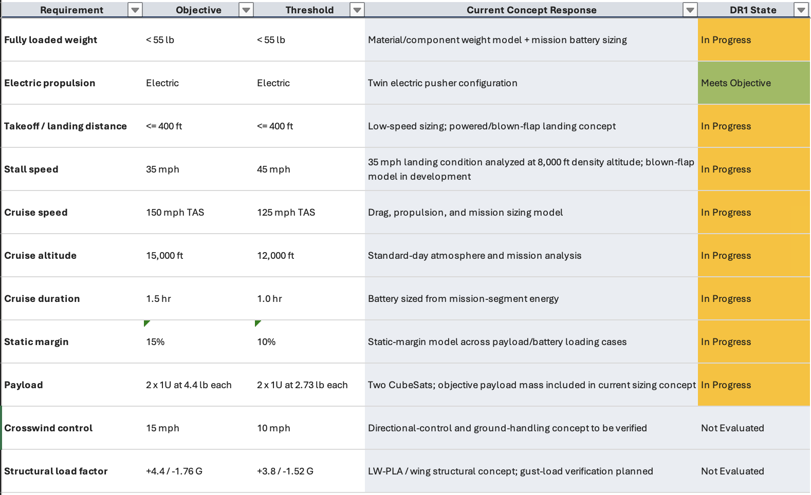
RFP Requirements Matrix
https://o365coloradoedu-my.sharepoint.com/:x:/r/personal/noju6274_colorado_edu/Documents/SeniorProj_RFPMatrix.xlsx?d=wcb930d652b0b4a6f84c19509cf3024b3&csf=1&web=1&e=EzohYa

